Slide 1
Discounting
Science and scenarios
Abatement costs
Instruments for emission reduction
Impacts of climate change; valuation
Economic impacts; marginals; distribution
Impacts and development
Adaptation policy
Optimal climate policy
Discounting, uncertainty, equity

Slide 2
Optimal Climate Policy
International agreements
First-best climate policy
Ancillary benefits
Time discounting
Ramsey rule
Hyperbolic discounting
Axiomatic discounting
Uncertainty
Equity

Slide 3
Optimal emission reduction
Climate change is long-term, uncertain, global problem
If you do not care about the distant future, remote probabilities, far-away lands, you do not care about climate change

Slide 4
Optimal emission reduction
Climate change is long-term, uncertain, global problem
If you do not care about the distant future, remote probabilities, far-away lands, you do not care about climate change

Slide 5
Social cost of carbon, $/tC
PRTP | Mode | Mean | SD
0% | 202 | 686 | 644
1% | 100 | 378 | 471
3% | 28 | 43 | 35
EU | 102 | Oct | 2020
California | 62 | Oct | 2020
Shenzen | 18 | Oct | 2020

Slide 6
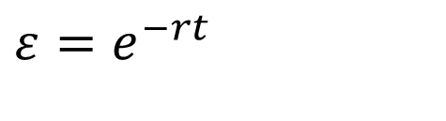
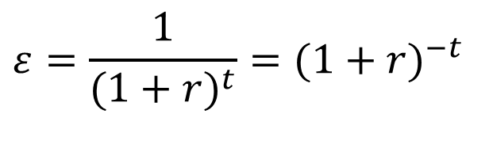
The Ramsey Rule
The net present value of $1 in t years time
You may be used to
The latter converges to the former if the time step goes to zero
$$ε=e^{−rt}$$
$$ε=\frac{1}{{(1+r)}^{t}}={(1+r)}^{−t}$$

Slide 7
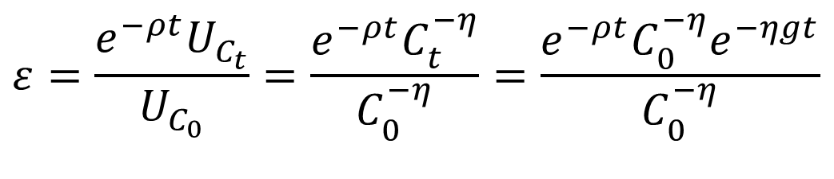
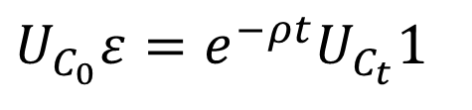
The Ramsey Rule
The net present value of $1 in t years time
Equate marginal utility now to marginal utility then, that is, you are indifferent between getting ε now or 1 later
Or
$$ε=e^{−rt}$$
$$U_{C_{0}}ε=e^{−ρt}U_{C_{t}}1$$
$$ε=\frac{e^{−ρt}U_{C_{t}}}{U_{C_{0}}}=\frac{e^{−ρt}C_{t}^{−η}}{C_{0}^{−η}}=\frac{e^{−ρt}C_{0}^{−η}e^{−ηgt}}{C_{0}^{−η}}$$

Slide 8
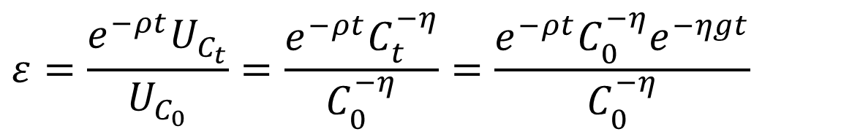
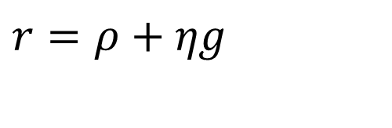
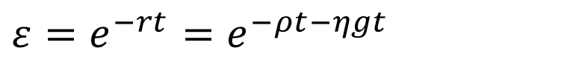
The Ramsey Rule -2
That is
Or
$$ε=\frac{e^{−ρt}U_{C_{t}}}{U_{C_{0}}}=\frac{e^{−ρt}C_{t}^{−η}}{C_{0}^{−η}}=\frac{e^{−ρt}C_{0}^{−η}e^{−ηgt}}{C_{0}^{−η}}$$
$$ε=e^{−rt}=e^{−ρt−ηgt}$$
$$r=ρ+ηg$$

Slide 11

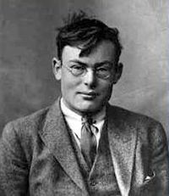

Time discounting
The Ramsey rule of discount
That is, we discount the future because
We will be richer and happier then
We are impatient
Note that the Ramsey rule describes the consumption side of intertemporal trade-offs – on the production side, there is the opportunity cost of capital
In equilibrium, the two are equal
$$r=ρ+ηg$$

Slide 12
Social cost of carbon, $/tC
PRTP | Mode | Mean | SD
0% | 202 | 686 | 644
1% | 100 | 378 | 471
3% | 28 | 43 | 35
EU | 102 | Oct | 2020
California | 62 | Oct | 2020
Shenzen | 18 | Oct | 2020

Slide 13
Choice of parameters
Discounting should
Reflect the will of the people
People discount the future, even though every philosopher since Aristotle has told them it’s immoral
Not ignore the far future
Be consistently applied across public policy
Trade-offs about future threats to human health should be independent from the policy arena
This cannot be resolved with exponential discounting

Slide 14
Optimal Climate Policy
International agreements
First-best climate policy
Ancillary benefits
Time discounting
Ramsey rule
Hyperbolic discounting
Axiomatic discounting
Uncertainty
Equity

Slide 15
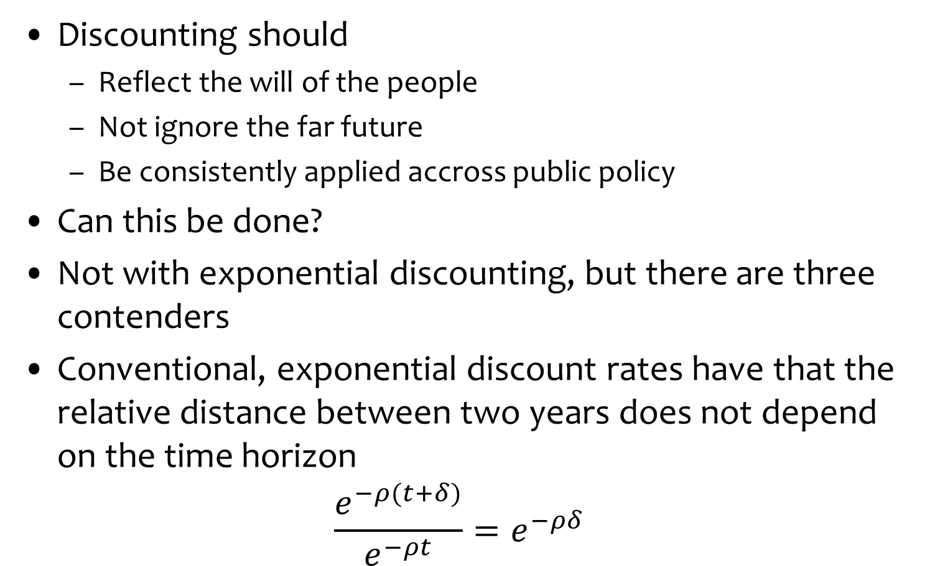
Alternative discounting
Discounting should
Reflect the will of the people
Not ignore the far future
Be consistently applied accross public policy
Can this be done?
Not with exponential discounting, but there are three contenders
Conventional, exponential discount rates have that the relative distance between two years does not depend on the time horizon
$$\frac{e^{−ρ(t+δ)}}{e^{−ρt}}=e^{−ρδ}$$

Slide 16
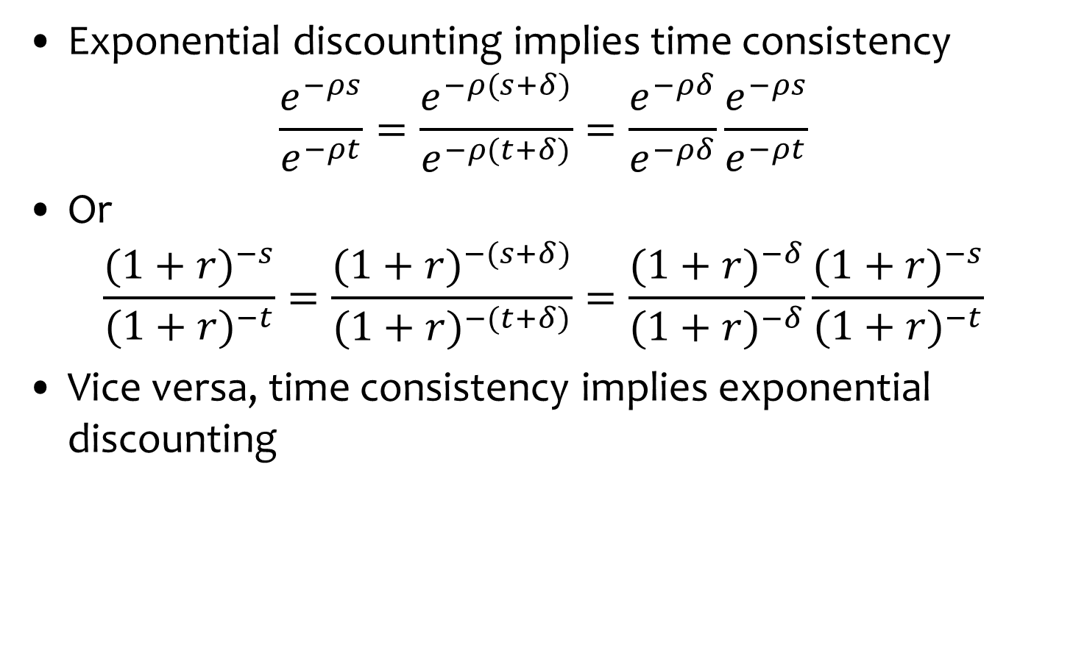
Time consistency
Exponential discounting implies time consistency
$$\frac{e^{−ρs}}{e^{−ρt}}=\frac{e^{−ρ(s+δ)}}{e^{−ρ(t+δ)}}=\frac{e^{−ρδ}}{e^{−ρδ}}\frac{e^{−ρs}}{e^{−ρt}}$$
Or
$$\frac{{(1+r)}^{−s}}{{(1+r)}^{−t}}=\frac{{(1+r)}^{−(s+δ)}}{{(1+r)}^{−(t+δ)}}=\frac{{(1+r)}^{−δ}}{{(1+r)}^{−δ}}\frac{{(1+r)}^{−s}}{{(1+r)}^{−t}}$$
Vice versa, time consistency implies exponential discounting

Slide 17
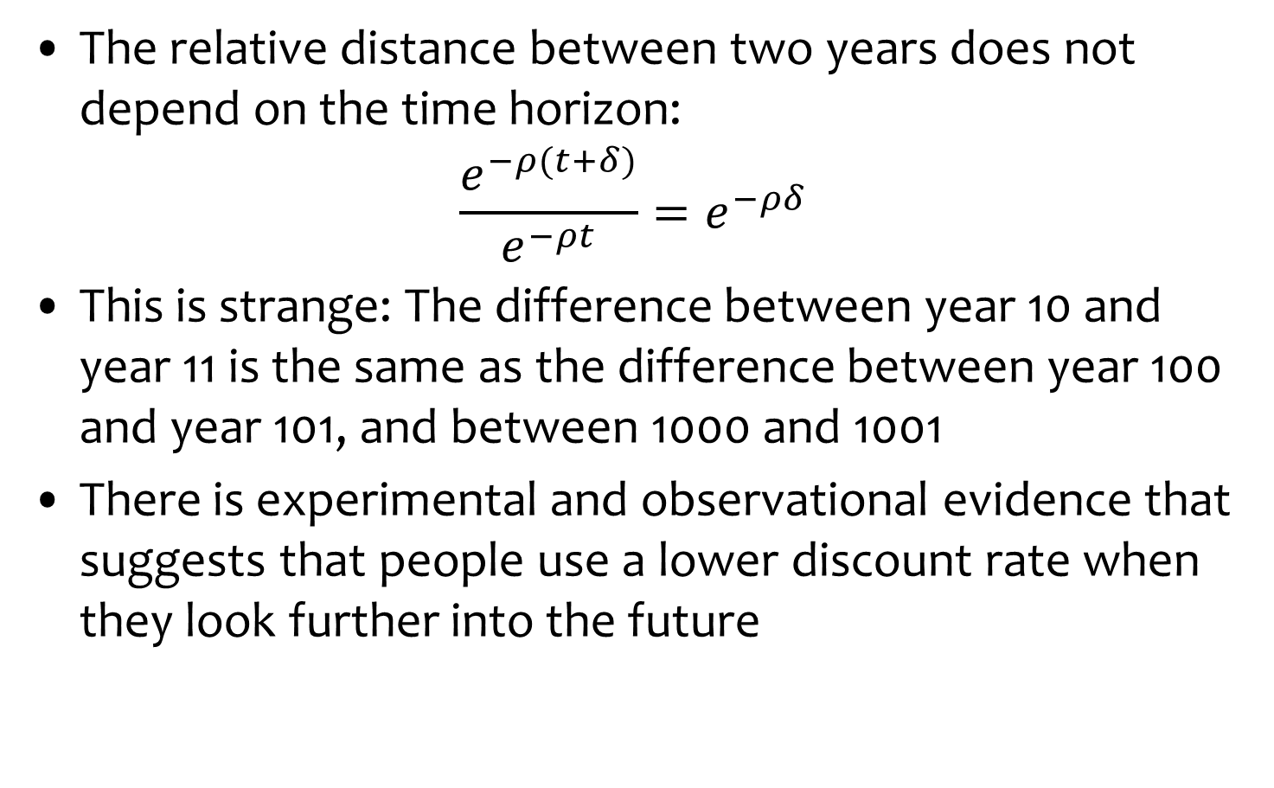
Hyperbolic Discount Rates
The relative distance between two years does not depend on the time horizon:
$$\frac{e^{−ρ(t+δ)}}{e^{−ρt}}=e^{−ρδ}$$
This is strange: The difference between year 10 and year 11 is the same as the difference between year 100 and year 101, and between 1000 and 1001
There is experimental and observational evidence that suggests that people use a lower discount rate when they look further into the future

Slide 18


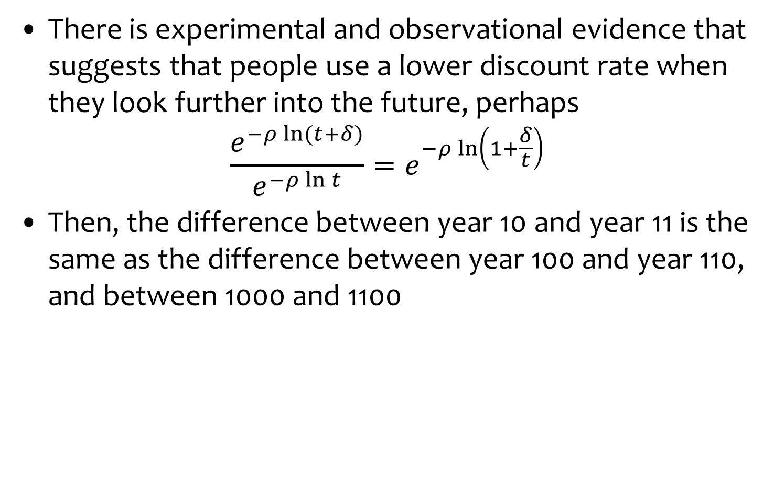
Hyperbolic Discount Rates -2
There is experimental and observational evidence that suggests that people use a lower discount rate when they look further into the future, perhaps
$$\frac{e^{−ρ\ln{(t+δ)}}}{e^{−ρ\ln{t}}}=e^{−ρ\ln\left(1+\frac{δ}{t}\right)}$$
Then, the difference between year 10 and year 11 is the same as the difference between year 100 and year 110, and between 1000 and 1100

Slide 19
Declining Discount Rates
A similar (but not identical) effect can be achieved through uncertainty

Slide 20
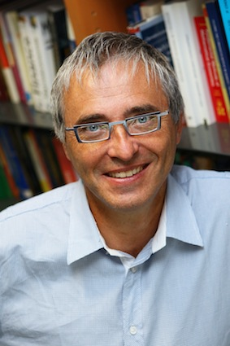

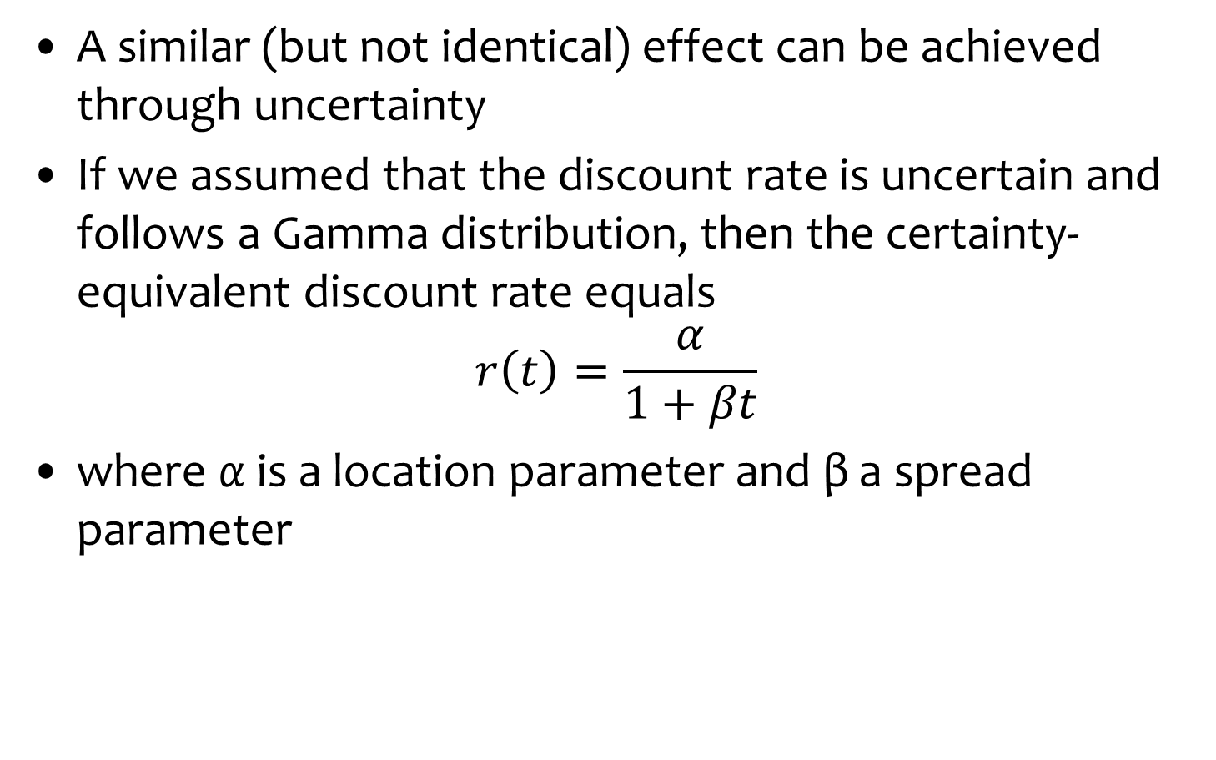
Declining Discount Rates -2
A similar (but not identical) effect can be achieved through uncertainty
If we assumed that the discount rate is uncertain and follows a Gamma distribution, then the certainty-equivalent discount rate equals
$$r\left(t\right)=\frac{α}{1+βt}$$
where α is a location parameter and β a spread parameter

Slide 21
Social cost of carbon, $/tC
 | DDR | Constant
Green Book | 22 | 8.1
Weitzman | 107 | 2.6

Slide 22
Optimal Climate Policy
International agreements
First-best climate policy
Ancillary benefits
Time discounting
Ramsey rule
Hyperbolic discounting
Axiomatic discounting
Uncertainty
Equity

Slide 23
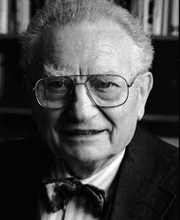
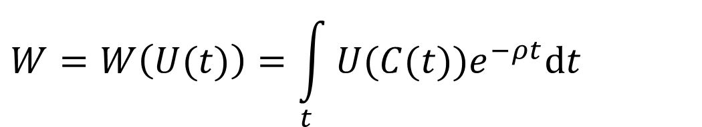
Exponential and Hyperbolic Discounting
Exponential discounting places insufficient weight on the distant future
Heal’s hyperbolic discounting is ad hoc
Weitzman’s gamma discounting is on firmer ground, but the argument is on part of the welfare function, rather than the whole welfare function
Exponential discounting is an ad hoc proposal by Samuelson, later axiomatized
$$W=W\left(U(t)\right)=\int_{t}{U(C(t))e^{−ρt}dt}$$

Slide 24
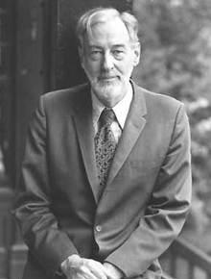
Alternative welfare functions
Over an infinite time horizon, a welfare function cannot simultaneously satisfy Strong Pareto and Anonimity
If one is better off and no one is worse, welfare improves
Discounted welfare violates Anonimity
1 1 2 1 1 1 …
1 2 1 1 1 1 …
Koopmans argued that Anonimity is less important

Slide 25

Alternative welfare functions -2
Chichilnisky replaced Anonimity with Non-Dictatorship and Independence

Slide 26
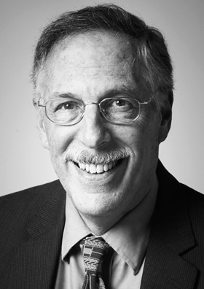
Overlapping generations
The standard growth models assume an infinitely-lived economic agent
Diamond showed that this is equivalent to assuming a dynast who owns all, but cares as much about his children’s welfare as he does about his own
This is peculiar for an individual
Less peculiar for a representative agent, who is composed of people saving for their first house, their children’s education, their pension, or a bequest to their grandchildren
But it’s Dictatorship of the Present

Slide 27

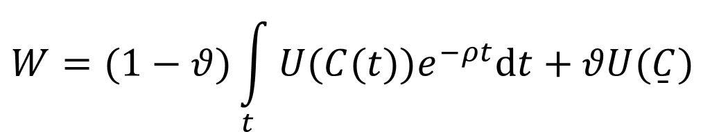
Alternative welfare functions -2
Chichilnisky replaced Anonimity with Non-Dictatorship and Independence
Welfare is then a weighted sum of net present welfare and welfare of the last generation
Alvarez-Cuadrado & Long dropped Independence
Welfare is then a weighted sum of net present welfare and welfare of the worst-off generation
As long as growth continues, this reduces optimal emission reduction
$$W=(1−θ)\int_{t}{U(C(t))e^{−ρt}dt}+θU(\overset{̱}{C})$$

Slide 28
Social cost of carbon, $/tC
 |  |  | 3% | 1% | 0%
Bentham |  |  | 25 | 105 | 296
Rawls | D=T² |  | 0.1 | 0.1
Rawls | D=T⁶ |  | 20.1 | 20.1
Bentham-Rawls | D=T² | θ=0.5 | 12.55 | 52.6 | 148.05
 | D=T⁶ | θ=0.5 | 22.55 | 62.6 | 158.05

